Slide 1
Cell Junctions
Lecture 8

Slide 2
Objectives
Three classes of cell junctions
Four specific examples of cell junctions and their components and roles/functions
desmosomes
adherens junction
tight junctions
gap junctions
Compare & contrast the cell junction types

Slide 3
Cell Junctions
Adhering or Anchoring Junctions
Desmosomes
Adherens Junction ("belt desmosome")
Hemidesmosomes
Occluding / Barrier Junctions
Tight Junctions
Communicating or Connecting Junctions
Gap Junctions

Slide 4
Desmosomes
Usually used by types of cells who tissues are subjected to extreme mechanical stress
These are anchoring junctions used as couplings to prevent cell separation
They link between and through cells
Desmosomes are commonly found in epidermal (skin) cells and cardiomyocytes, these types of cells stressed greatly

Slide 5
Desmosome Features
Plaque
button-like thickening of the membranes of the two cells
Cadherins
protein filaments extend from plaques, fit like teeth of a zipper in intercellular space
This is the link between cells
Intermediate filaments
These form the link through a cell that extend from a plaque on one side of cell to a plaque on the other side of the cell
This is the link through a cell

Slide 6
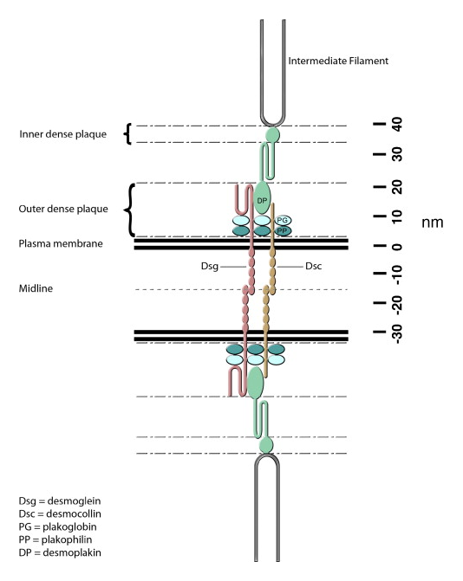
Desmosome Structure
The intercellular space shows the connections by cadherin family of proteins called desmoglein (Dsg) & desmocolin (Dsc)
These cadherins extend through the plasma membranes and connect with the proteins that make up the plaque. These plaque proteins are plakophilin and plakoglobin
Desmoplakin (DP) is a protein that connects plakoglobin (PG)
The complex of plaque proteins (PP, PG, DP) connect the cadherins to the intermediate filaments

Slide 7
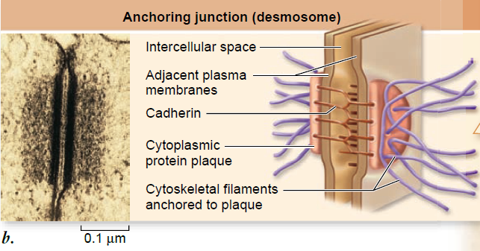
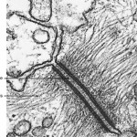
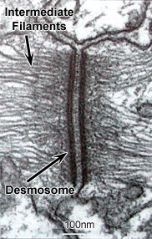
http://www.derm101.com/wp-content/uploads/ac01g020-150x150.jpg

Slide 8
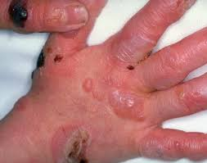
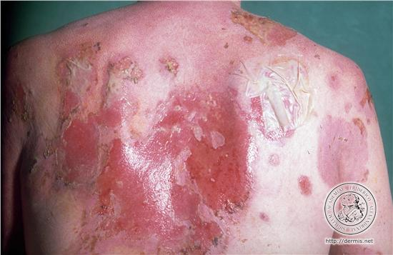
Desmosome Dysfunction
Epidermis bullosa simplex
defects in genes for keratins
skins blisters easily from rubbing, scratching
severe cases: mouth or intestinal blistering
Pemphigus
autoimmunity to cadherin family proteins desmoglein that connect cells
several types of pemphigus with different appearances
Lethal acantholytic epidermolysis bullosa
partial deletion of the desmoplakin gene
this presents usually after birth and is lethal in infancy
Skin fragility syndrome (ectodermal dysplasia)
defect in the plakophilin gene

Slide 9
Adherens Junction
This junction is similar to desmosomes at least in function
The important difference with desmosomes is that the through-cell filaments are not intermediate filaments, but rather actin filaments (F-actin)
Actin is a protein that interacts with myosin in muscle contraction

Slide 10
Adherens Junction Features
Plaque (adhesion plaques)
like desmosomes, a dense collection of proteins forms on the intracellular side that looks like a plaque in microscopy
Cadherins
these are the molecules that connect the two cells together
a different set of cadherins from those in desmosomes do the actual linking of the cells between the two membranes
Linking proteins
These form a ring around the cells, connecting to other plaques on the cell
Actin filaments
These form a ring around the cells, connecting to other plaques on the cell

Slide 11
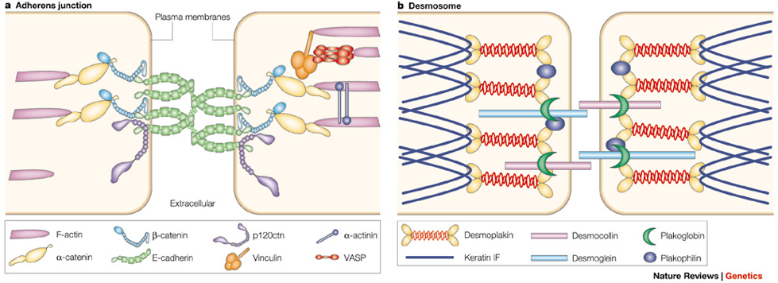
Comparing Adherens Junctions to Desmosomes
Although the actual proteins differ, the protein types are similar between the adherens junctions and the desmosomes
cadherins are the proteins between the cells linking them
and the proteins that connect to the cadherins (via linking proteins) are filaments that connect the membranes through a cytoskeleton

Slide 12
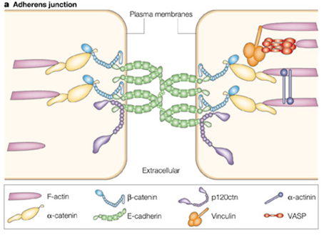
Molecular Details
The green molecules in between cells are E-cadherins, which are homodimers that make the binding between cells
The dark blue-colored molecule is called p120, an "armadillo protein" appears to stabilize the E-cadherin
The light blue-colored beta-catenin is a chain link between E-cadherin and yellow-colored alpha-catenin
Alpha-catenin connects the complex to filamentous actin (F-actin)
Plakoglobin in desmosomes is also called gamma-catenin, and has a sequence quite similar to beta-catenin
Vinculin and VASP are proteins commonly found linking actin filaments to membrane proteins involved in cell anchoring

Slide 13
Tight Junctions
Tight junctions are occluding junctions
Regulate paracellular transport pathway
This means they guard the space between cells (the "alleyways")
They are not impermeable to everything, but they can open a gate to molecules or ions or close it
Like desmosomes, they also contribute to holding cells together as a layer
Most likely to form with an epithelial (one cell-thick) cell layer

Slide 14
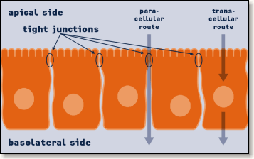
Transcellular & Paracellular Paths
Molecules & ions of all kinds have two ways of being transported from the relative outside (apical side) of the body to the inside (basolateral side) of the body: through cells or around them
Tight junctions hold the gate around—down the alleyways—of barrier cell layers.
TJs are are generally found on:
intestinal mucosa epithelium (near the brush border)
distal convulted tubules and collecting ducts in kidney nephrons
bile ducts within liver

Slide 15
Tight Junction Features
Tight barrier
Permeability for hydropholic nonelectrolytes is up to 0.4 nm
diameter of H₂O: 0.3 nm
10 nm particles
These appear as rows of interweaving strands, each particle space 18 nm center-to-center from each other
Claudin proteins & the occludin protein
These are the proteins that connect between the cells and are believed to form the tight barrier to diffusion to all but the smallest ions or molecules

Slide 16
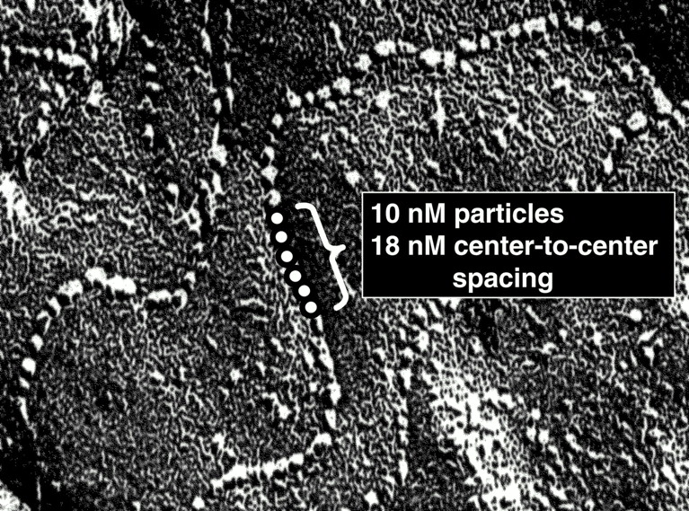
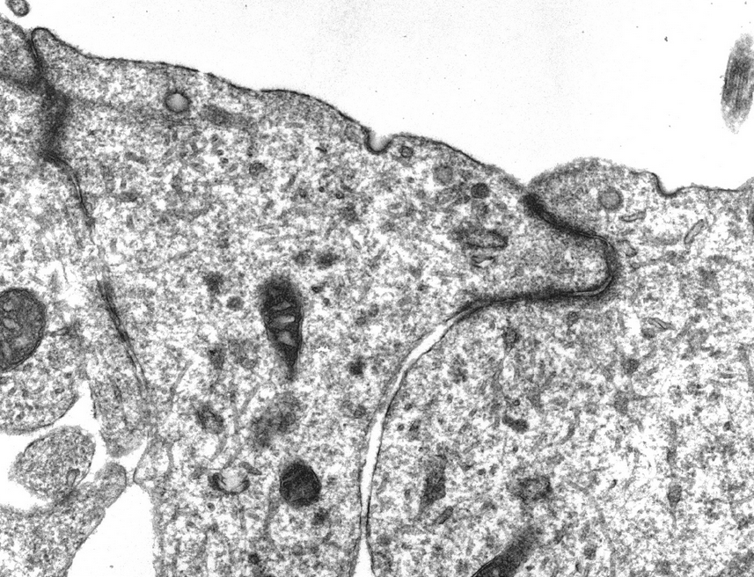
Freeze fracture electron microscopy (lower left) divides the lipid bilayer of the membrane to reveal the 10 nm particles
The transmission electron micrograph (lower right) shows the tight junction
tight junction
http://physiologyonline.physiology.org/content/16/3/126

Slide 17
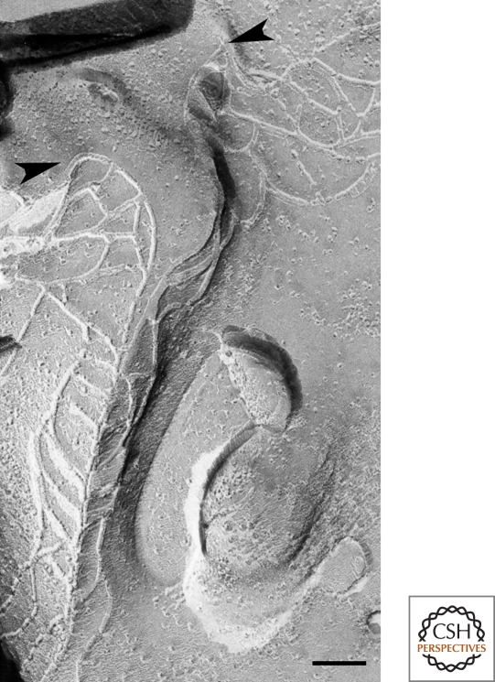
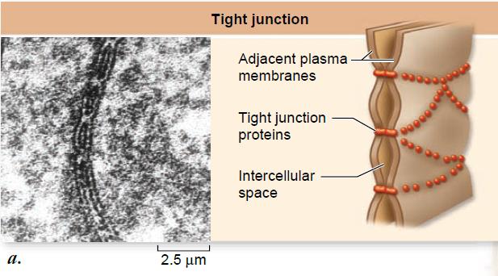
Another closer look at TJs with TEM (lower left) shows oval openings, which are interpreted in the illustration
Another freeze fracture EM (lower right) shows another view of how the weaving pattern can occur as it circles the cell
17

Slide 18
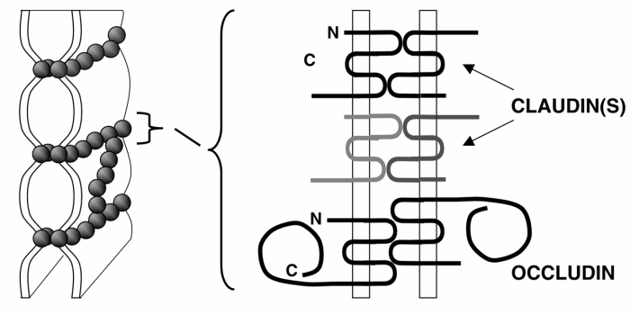
The Main Components of TJs
The 10 nm particles are made of a cluster of proteins, but the main proteins involved in connecting with each other are the claudin protein family and the protein occludin

Slide 19
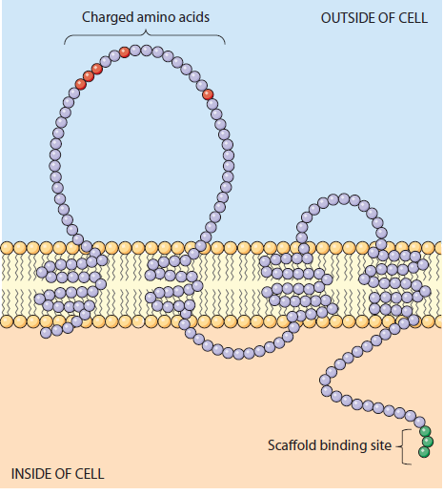
The Biomolecules of Tight Junctions
Many proteins make TJs: on this and the next slide, you can see the proteins identified, some described in great detail
claudins: these membrane proteins (4 transmembrane segments) form the net (semipermeable seal). Some claudins (there are at least 20 of them having different properties) make the seal tighter (impermeable) while other are weaved into promote paracellular transport. One large extracellular loop of claudins has many charged amino acids and this may be a barrier to ions passing (or specific ones being allowed)

Slide 20
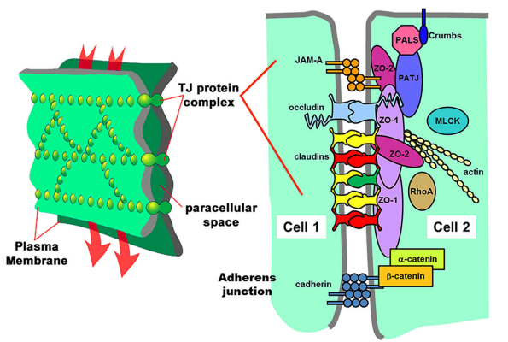
The Biomolecules of Tight Junctions
occludin: similar to claudin in structure, but function unknown
JAM-A: (JAM=junctional adhesion molecule) is a member of the immunoglobulin superfamily
cingulin
7H6:
ZO-1, -2, -3

Slide 21
Tight Junction Dysfunction
Familial hypomagnesia with hypercalcuria and nephrocalcinosis (FHHNC) is a severe imbalance of Mg²⁺ and Ca²⁺ and is connected to mutations in claudin-16
Crohn's disease may be a failure of tight junction function
Ulcerative colitis may result in TJ dysfunction secondary to inflammatory processes

Slide 22
Gap Junctions
Gap junctions cause adjoining cells to form a "partial union of their cytoplasm" (syncytium)
shared cytosol: metabolic coupling of cells
Permeability is for substances which are up to 1200 Da, which covers many of the small organic and inorganic molecules
metabolites: ATP
ions: Ca²⁺ (important in signaling!)
antioxidants: glutathione
signaling molecules: cyclic AMP, inositol trisphosphate (IP₃)
Polymeric (large) molecules would be impermeable

Slide 23
Gap Junction Features
Connexons
This is the special name for the cylindrical channels that connect the cytosol between two cells
Connexins
Connexins are the single polypeptide functional proteins that form connexons by oligomerizing with 5 other connexins to form a hexagonal connexon hemichannel
Plaques
These are formed by clusterings of connexons A single gap junction can have from a few to thousands of connexons clustered in the junction
Gap junction equivalent in plants: plasmodesmata

Slide 24
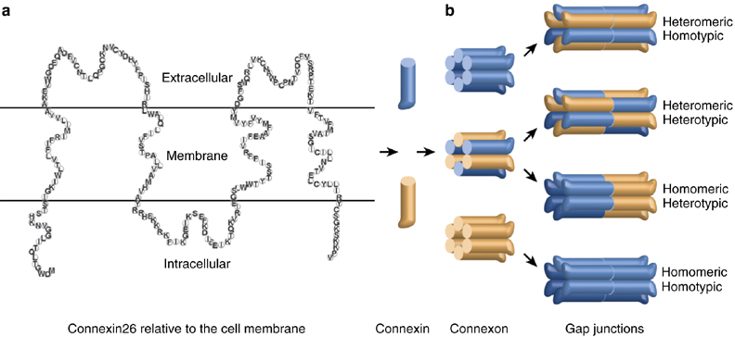
Connexon Structure
Each cell will make connexin proteins
The connexin protein (a single polypeptide) is made as a transmembrane protein that crosses the membrane four times, and the N-terminal and C-terminal tails will be on the inside of the cell
Six (6) of those proteins will assemble into a hemichannel with the cells before they have even reached the cell surface

Slide 25
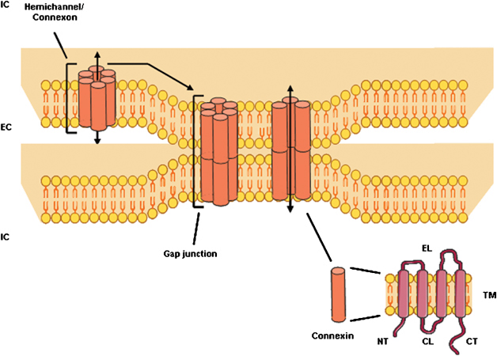
Gap Junction Building
When hemichannels have reached the cell surface, they look for hemichannels from the other cell in order to make a connection for the full channel, and the fully functioning connexon
More connexons (complete) will form in a cluster around previously formed connexons, and the gap junction plaque forms
Gap junctions exist for only a few hours: connexons will disperse and hemichannels removed from the membrane surface

Slide 26
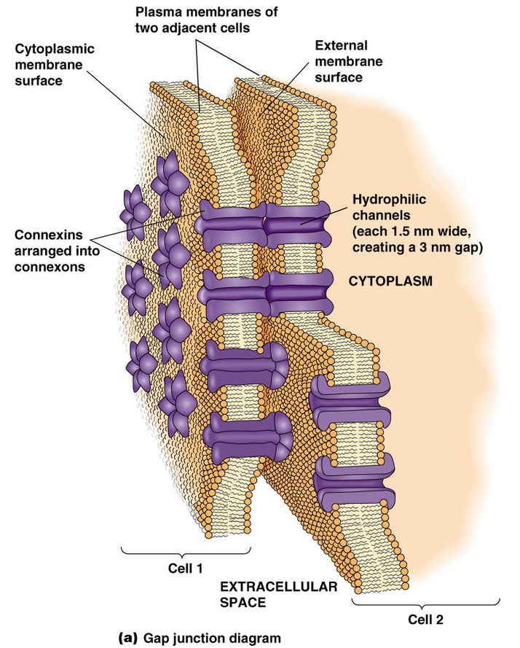
A nice illustration again in Becker's book
Note that 6-connexin subunit hemichannels form in the membrane of one cell, and they try to align with the hemichannels of the other cell, the alignment creating the porous channel

Slide 27
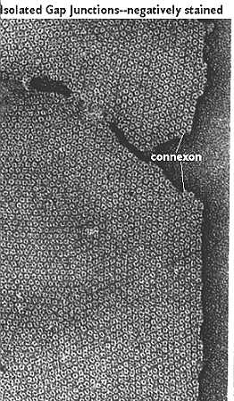
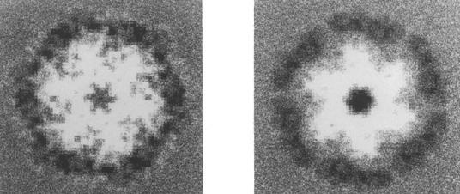
Experimental evidence, namely electron micrographs (leftmost) and filtered EM images (two rightmost) of connexons as seen looking down the axis of the channels. The leftmost image shows how connexons are clustered to form the gap junction plaque.
http://163.178.103.176/Tema1G/Grupos1/GermanT1/GATP5/Oclu4_files/membr20.jpg
http://php.med.unsw.edu.au/cellbiology/images/6/66/Electron_Micrograph_Filtered_Image_of_Two_Connexons.jpg

Slide 28
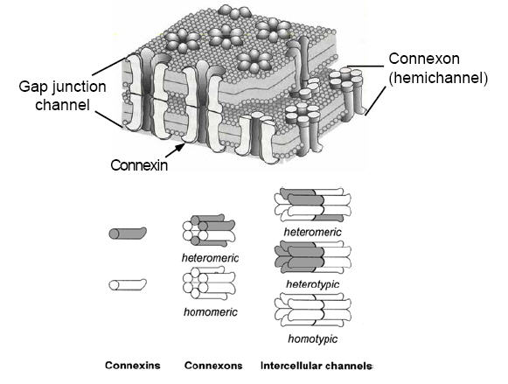
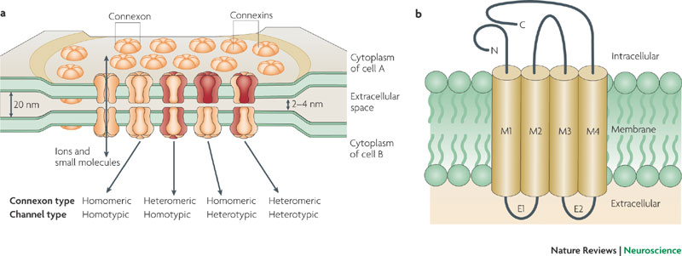
These figures and their legends provide slightly more information that may be informative or enlightening to you. You are not required to know the extra detail given in the figures or the legends though: only the basics already presented
a | Gap junctions are formed between the opposing membranes of neighbouring cells. Hemichannels on each side dock to one another to form conductive channels between the two cells. An extended field of these channels forms a gap junctional plaque. Each hemichannel, or connexon, is comprised of 6 connexin protein subunits that are oriented perpendicular to the cells' membranes to form a central pore. This central pore serves as a conduit for ions and low-molecular-mass molecules of up to 1,000 Da. Connexons can contain only one type of connexin subunit (homomeric connexons) or a mixture of different connexins (heteromeric connexons). Gap junctional channels can consist of two of the same connexon (homotypic channels) or of connexons with different subunit compositions (heterotypic channels). b | Connexin subunits are proteins that have four transmembrane domains, two extracellular loops (E1 and E2) and one intracellular loop, as well as carboxyl and amino termini in the cytoplasm. Although the four transmembrane domains (M1–M4) share a conservative sequence that is important for docking in the cellular membrane, their cytoplasmic domains vary in length and amino acid sequence. Regulation of the three-dimensional connexin structure, which underlies the opening and closing of gap junction channels, is mediated at the cytoplasmic regions.

Slide 29
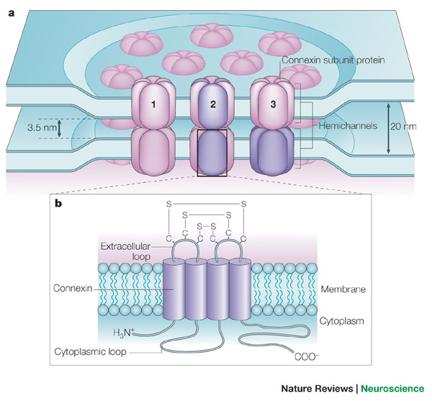
Again, another set of figures and their legends providing hopefully enlightening, certainly more informative detail
Consider the possibility you might be interested in delving into this detail in molecular structure, function or roles in disease and disorders for your oral presentations
Hemichannels in apposed plasma membranes of neighbouring cells can dock to each other and form gap junction channels. Three different types of gap junction have been reported — homomeric/homotypic (1), heteromeric (2) and heterotypic (3) — depending on their molecular composition. Homotypic or heterotypic gap junctions comprise two identical or two different types of hemichannel, respectively. Homomeric or heteromeric hemichannels are composed of one or more connexin (or possibly pannexin) isoforms, respectively. Each hemichannel represents an assembly of six connexin protein subunits. b | Connexin protein subunits are tetra-spanning membrane proteins that share three conserved extracellular cysteine residues, which are crucial for docking. The subunits vary mainly in their cytoplasmic loop and carboxy-terminal region. S–S represents conserved disulphide bonds in the extracellular domains of connexins. Pannexin proteins are sequence-related to the invertebrate innexin family and can also form intercellular gap junction channels.

Slide 30
Hemidesmosomes
These help the cell to adhere to an extracellular matrix (basal lamina) instead of to another cell
Their description is beyond the scope of the course and knowledge of structure and function will not be assessed in the student

Slide 31
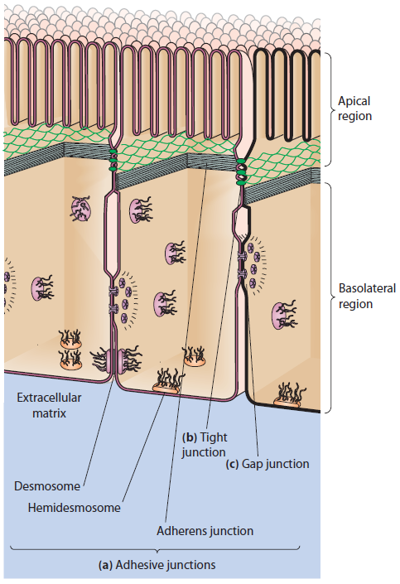
This impressive illustration from Becker's book shows a nice perspective of the cell connections considered adhesive as well as the occlusive (tight junctions) and communicating (gap junction)
Note the circumferential ring created by adherens junctions (the green-colored net)

Slide 32
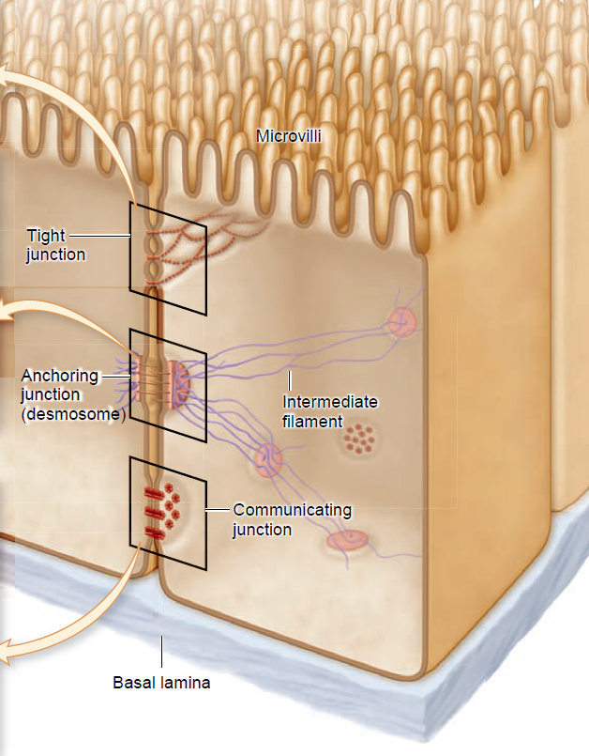
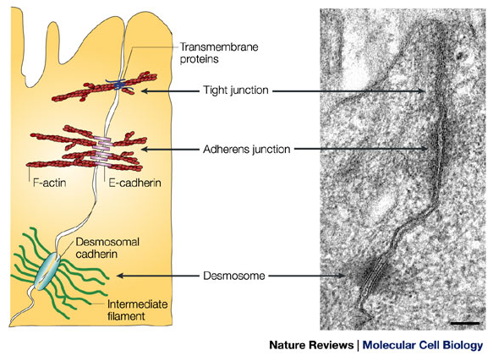
These additional illustrations offer other views of the cell junctions presented here

Slide 33
Reading (Sources)
Becker's WotC: Chapter 17: 481-487
Raven: Chap 4.8
Marieb: Chapter 3: p 67

